Slide 1
ROMANTICISM Late 18th century-Mid 19th century
History of Western Art
BFA-II (Visual Arts)
Course Incharge: Ms. Farah Khan
Institute of Design & Visual Arts (LCWU)

Slide 2
“Romanticism is precisely situated neither in choice of subject, nor exact truth, but in the way of feeling” Charles Baudelaire
“To say the word Romanticism is to say modern art - that is, intimacy, spirituality, color, aspiration towards the infinite, expressed by every means available to the arts”
Charles Baudelaire

Slide 3
ROMANTICISM
The term Romanticism was borrowed from Romantic language.
It started after the Revolution of 1789, when French Revolution was at its peak.
At the end of the 18th century and well into the 19th century, Romanticism quickly spread throughout Europe and the United States to challenge the rational ideal held so tightly during the Enlightenment. The artists emphasized that sense and emotions - not simply reason and order - were equally important means of understanding and experiencing the world. Romanticism celebrated the individual imagination and intuition in the enduring search for individual rights and liberty. Its ideals of the creative, subjective powers of the artist fueled avant-garde movements well into the 20th century.
It was basically a reaction against the materialism of classical and Neo-classical art. And was also partly a reaction to the Industrial Revolution.
Romanticist practitioners found their voices across all genres, including literature, music, art, and architecture. Reacting against the sober style of Neoclassicism preferred by most countries’ academies, the far reaching international movement valued originality, inspiration, and imagination, thus promoting a variety of styles within the movement. Additionally, in an effort to stem the tide of increasing industrialization, many of the Romanticists emphasized the individual’s connection to nature and an idealized past.
In part prompted by the idealism of the French Revolution, Romanticism embraced the struggles for freedom and equality and the promotion of justice. Painters began using current events and atrocities to shed light on injustices in dramatic compositions that rivaled the more staid Neoclassical history paintings accepted by national academies.

Slide 4
ROMANTICISM
Romanticism embraced individuality and subjectivity to counteract the excessive insistence on logical thought. Artists began exploring various emotional and psychological states as well as moods. The preoccupation with the hero and the genius translated to new views of the artist as a brilliant creator who was unburdened by academic dictate and tastes. As the French poet Charles Baudelaire described it, “Romanticism is precisely situated neither in choice of subject nor in exact truth, but in a way of feeling”.
In many countries, Romantic painters turned their attention to nature and plein air painting, or painting out of doors. Works based on close observation of the landscape as well as the sky and atmosphere elevated landscape painting to a new, more respectful level. While some artists emphasized humans at one with and a part of nature, others portrayed nature's power and unpredictability, evoking a feeling of the sublime - awe mixed with terror - in the viewer.
Romanticism was closely bound up with the emergence of newly found nationalism that swept many countries after the American Revolution. Emphasizing local folklore, traditions, and landscapes, Romanticists provided the visual imagery that further spurred national identity and pride. Romantic painters combined the ideal with the particular, imbuing their paintings with a call to spiritual renewal that would usher in an age of freedom and liberties not yet seen.

Slide 5
MAIN FEATURES OF ROMANTICISM
Romantic art was inspired from the writings of Romantic writers like Shakespeare, Goethe, Byron etc. They not only provide them the subjects but also different philosophies. Basically feelings, inspirations and Ideals were taken from them.
It was based on Nature + Feeling. They felt that beauty could be felt in nature.
Imagination+ Feeling+ Intuition
For them colors were more integral to highlight their feelings and emotions.
The movement emphasized intense emotion as an authentic source of aesthetic experience.
As a result loose brush stroke technique was adopted.
This movement expressed the concept of individualism and freedom of expression.
They were also inspired by the 17th century Baroque Art especially from Rubens.
There art was not static rather it was full of action (the Glorification of force was highlighted).
Romantics were fond of travelling, so the exotic elements were present in their works as well.
It was rather restless, vague, complex, picturesque, colorful, organic, irregular, emotional, sublime and exotic. Diversity of expression was also there.
Crowded compositions were having angular arrangement of lines.
Major artists of the movement were Gericault, Delacroix, Goya, Constable and Turner.

Slide 6
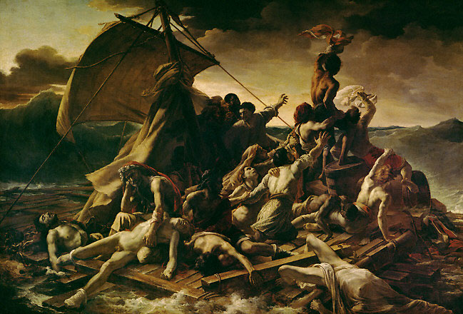
The Raft of the Medusa by Gericault

Slide 7
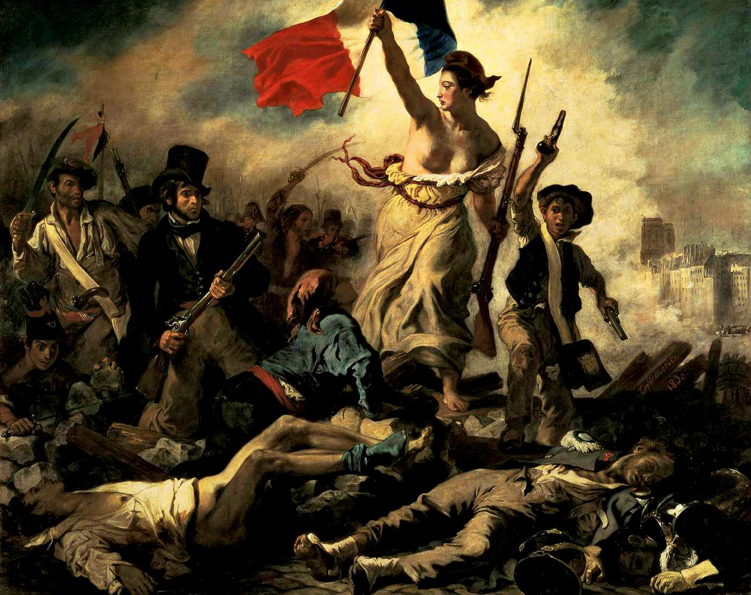
Liberty Leading the People by Delacroix

Slide 8
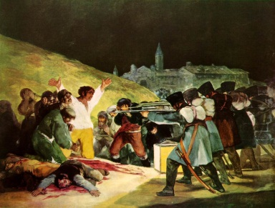
The 3rd of May 1808 by Goya

Slide 9
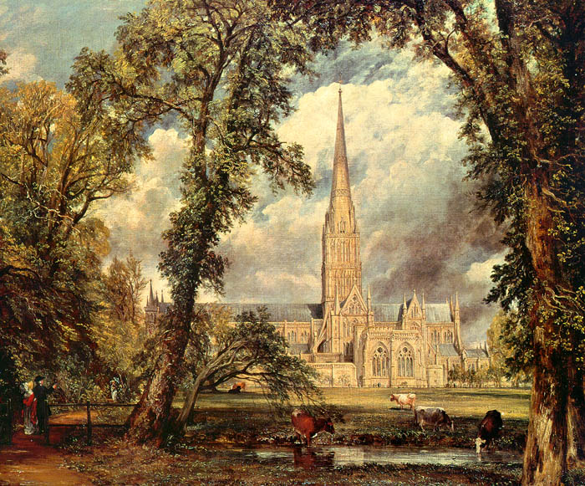
Salisbury Cathedral by Constable

Slide 10
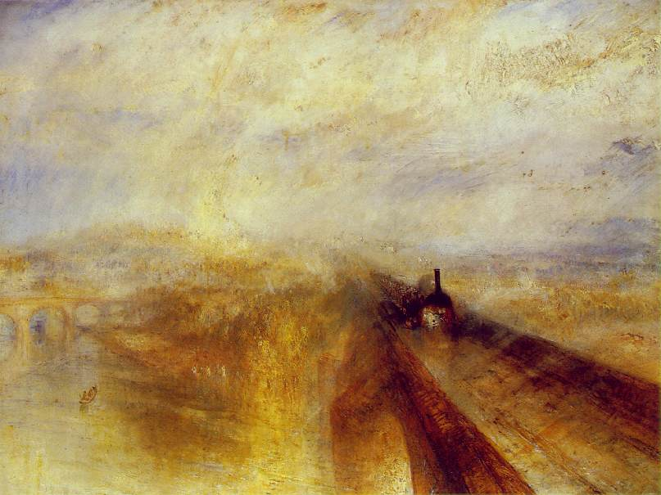
Rain, Steam and Speed by Turner

